Slide 1
Assembler Directives
Dr. Manju Khurana
Assistant Professor, CSED
TIET, Patiala
manju.khurana@thapar.edu

Slide 2
Assembler Directives
The instructions that will give the information to assembler for performing assembling are called Assembler Directives.
These assembler directives are not executed by microprocessor, so they are also called dummy or pseudo instructions.
When Assembler performs assembling:
Instructions are translated from assembly language to the machine language.
Each byte of the instruction code or data is allotted effective address of one memory location.

Slide 3
1. DB (Define Byte)
The assembler directive creates storage for a byte or a group of bytes and optionally assigns starting values.
Examples are:
DB 12H, 23H, 45H, 56H
NEXT DB 12, 34, 45
DB 100 DUP (0)
DB 100 DUP (?)
DB ‘DURG’

Slide 4
2. DW (Define Word)
It is used for memory location allotment of data word (16 bits), i.e. it is allotted two memory locations for each word.
Examples are:
DW 93H, 0ABCDH, 6745H
NEXT DW 12H, 0AB34H, 4567H
DW 200 DUP (0ABCDH)
DW 100 DUP (?)

Slide 5
3. DD (Define Double Word)
It is used for memory location allotment of data double word (32 bits), it creates storage for a 32-bit double word variables, with the option of giving it a starting value.
Example is:
NEXT DD 12345678H, 7890H, 0H

Slide 6
4. DQ (Define Quad Word)
It is used for memory location allotment of data quad word (64 bits), it creates storage for a 64-bit double word variables, with the option of giving it a starting value.
Example is:
DURG DQ 123456789ABCDEF0H, 8988H, 515H

Slide 7
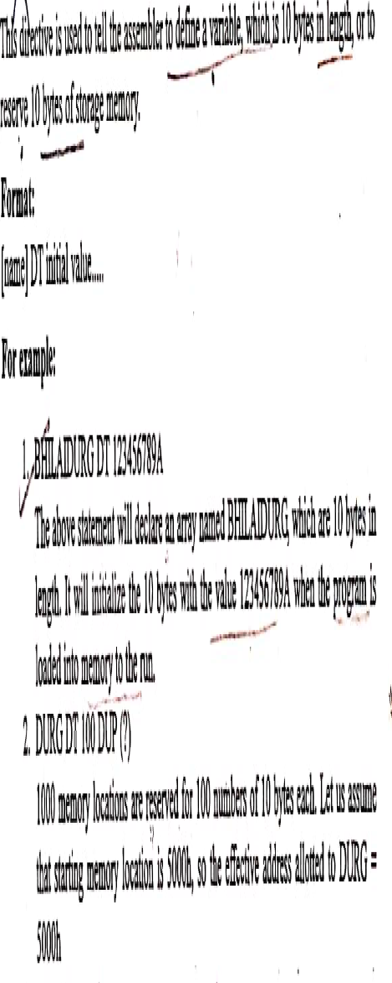
5. DT (Define Ten Bytes)

Slide 8

6. ASSUME

Slide 9
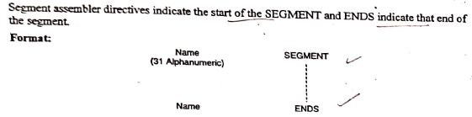
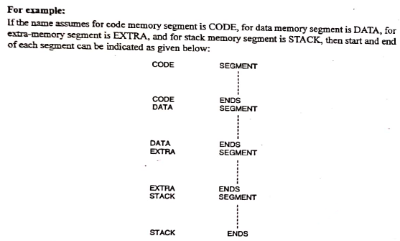
7. SEGMENT and ENDS

Slide 10

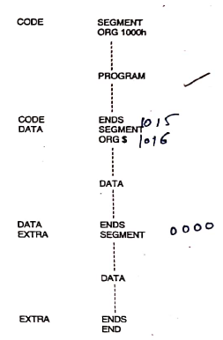
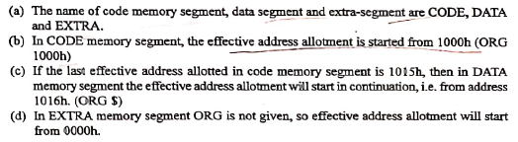
8. ORG (Originate)

Slide 11

9. END

Slide 12
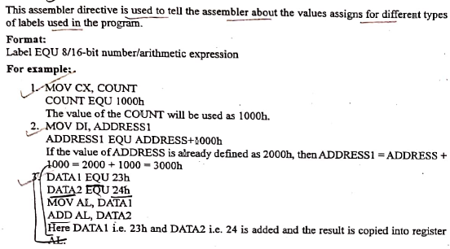
10. EQU

Slide 13
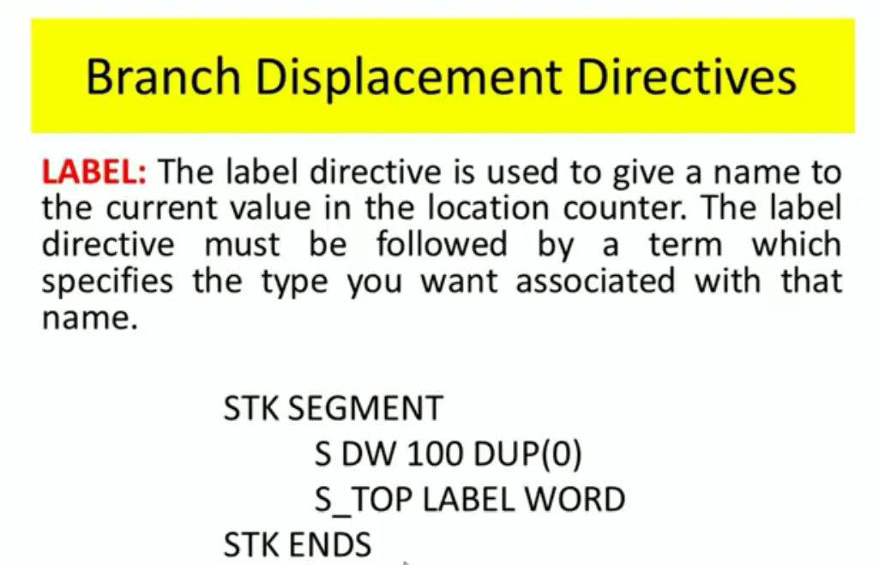
11. LABEL

Slide 14
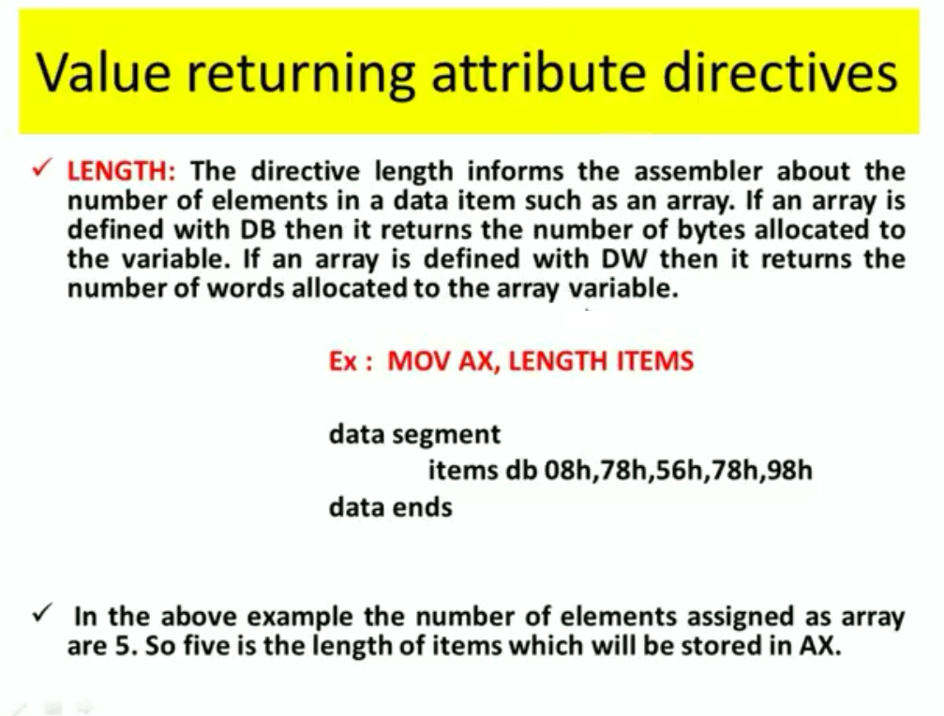
12. LENGTH

Slide 15
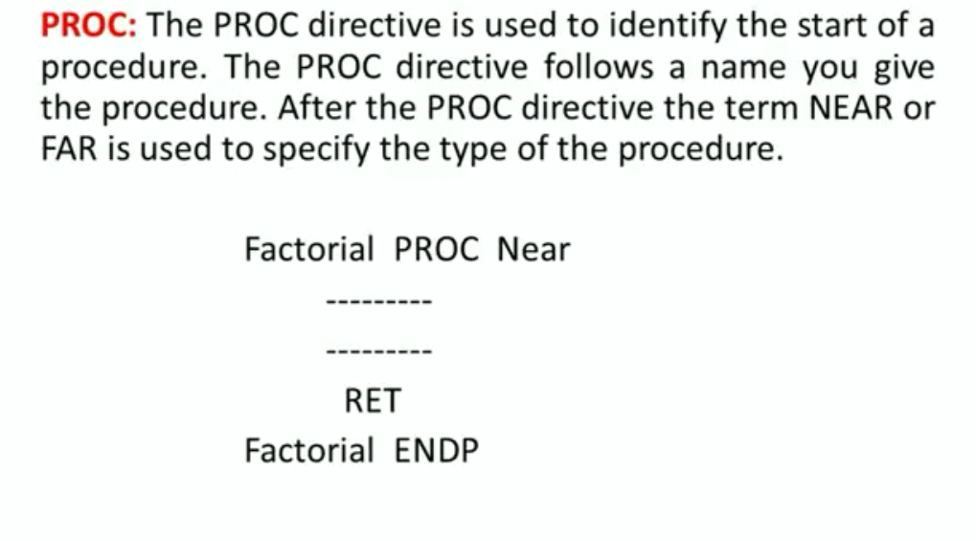
13. PROC and ENDP

Slide 16
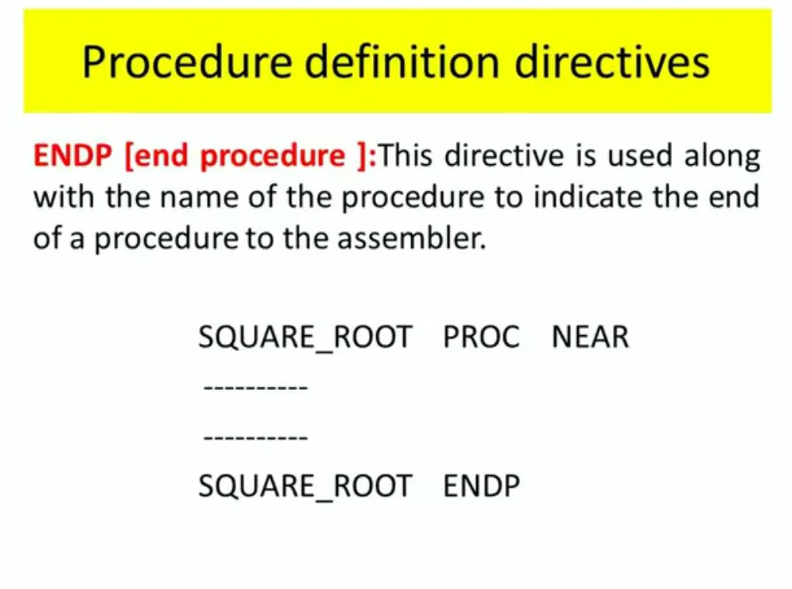
13. PROC and ENDP

Slide 17
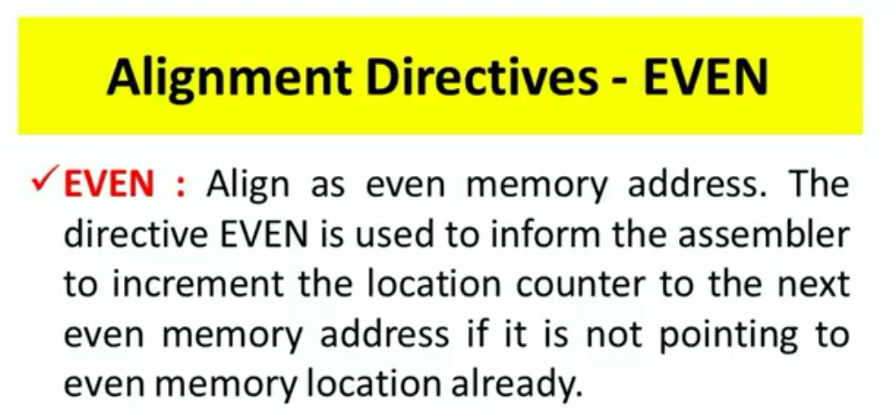
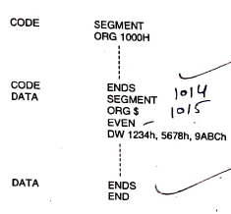
14. EVEN

Slide 18
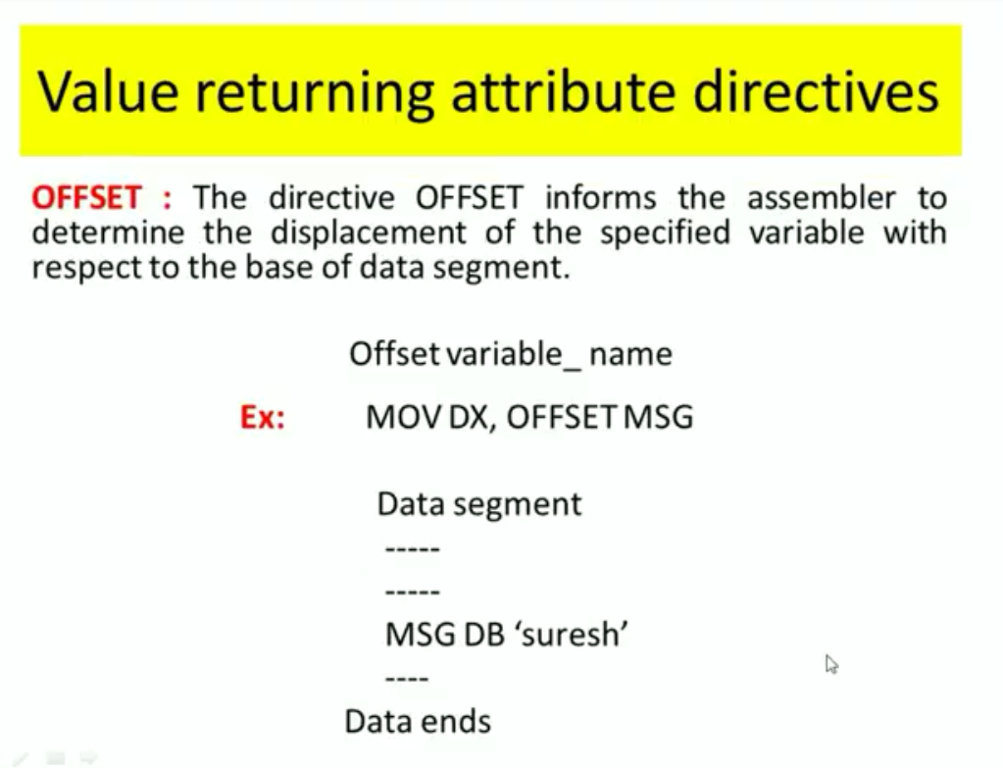
15. OFFSET

Slide 19


